Slide 1

WEEK 4
JavaScript Basic II Level 4 Introduction to Internet Software Architecture

Slide 2
Week 4 Lecture Topic
Arrow Function
Anonymous Function
IIFE (Immediately Invoked Function Expression)
Higher Order Function
Map
Reduce
Filter
ForEach Iteration
DOM and Virtual DOM

Slide 3

Introduction
1. JavaScript Basic
1.1. Arrow Functions
1.2. Anonymous Functions
1.3. IIFE (Immediately Invoked Function Expression)
1.4 Higher Order Functions
1.4.1 Map
1.4.2 Reduce
1.4.3 Filter
1.4.4 ForEach
1.6 DOM and Virtual DOM
1.7 JavaScript Selectors
1.8 JavaScript Events and event handlers
2. Learn more
JavaScript Basics II

Slide 4
Arrow Functions
1. JavaScript Basic
1.1. Arrow Functions
1.2. Anonymous Functions
1.3. IIFE (Immediately Invoked Function Expression)
1.4 Higher Order Functions
1.4.1 Map
1.4.2 Reduce
1.4.3 Filter
1.4.4 ForEach
1.6 DOM and Virtual DOM
1.7 JavaScript Selectors
1.8 JavaScript Events and event handlers
2. Learn more
Arrow functions were introduced in ES6.
We use arrow function to write shorter function syntax.
The Arrow function does not bind the “this” keyword.
A regular function tends to bind “this” keyword to its preceding object.
hello = function(){
return “Hello World”;
}
hello = () => “Hello World”;

Slide 5
Arrow Functions
1. JavaScript Basic
1.1. Arrow Functions
1.2. Anonymous Functions
1.3. IIFE (Immediately Invoked Function Expression)
1.4 Higher Order Functions
1.4.1 Map
1.4.2 Reduce
1.4.3 Filter
1.4.4 ForEach
1.6 DOM and Virtual DOM
1.7 JavaScript Selectors
1.8 JavaScript Events and event handlers
2. Learn more
Lets create a constructor function then create an instance of it.
As you should know, in the constructor function’s instance. “this” keyword is bound to the object being created, in this case “a”.
That is why we get “0” when we console.log it.
function Counter(){
this.num = 0;
}
var a = new Counter();
console.log(a.num);
// Returns 0

Slide 6
Arrow Functions
1. JavaScript Basic
1.1. Arrow Functions
1.2. Anonymous Functions
1.3. IIFE (Immediately Invoked Function Expression)
1.4 Higher Order Functions
1.4.1 Map
1.4.2 Reduce
1.4.3 Filter
1.4.4 ForEach
1.6 DOM and Virtual DOM
1.7 JavaScript Selectors
1.8 JavaScript Events and event handlers
2. Learn more
What if we want to increase the value of “a.num” every second?
We can use the setInterval() function. It is a function that calls a function after a set number of milliseconds.
function Counter() {
this.num = 0;
this.timer = setInterval(function() {
this.num++;
console.log(this.num);
}, 1000);
}
var b = new Counter();

Slide 7
Arrow Functions
1. JavaScript Basic
1.1. Arrow Functions
1.2. Anonymous Functions
1.3. IIFE (Immediately Invoked Function Expression)
1.4 Higher Order Functions
1.4.1 Map
1.4.2 Reduce
1.4.3 Filter
1.4.4 ForEach
1.6 DOM and Virtual DOM
1.7 JavaScript Selectors
1.8 JavaScript Events and event handlers
2. Learn more
As you can see, the result was not as the expected one. So what went wrong?
Lets clear the annoying interval first with clearInterval() function.
Our setInterval() function is being called on a declared object. It isn’t being called with the “new” keyword. setInterval is just a normal function.
The value of this in setInterval is being bound to the global object or the window object.
clearInterval(b.timer);

Slide 8
Arrow Functions
1. JavaScript Basic
1.1. Arrow Functions
1.2. Anonymous Functions
1.3. IIFE (Immediately Invoked Function Expression)
1.4 Higher Order Functions
1.4.1 Map
1.4.2 Reduce
1.4.3 Filter
1.4.4 ForEach
1.6 DOM and Virtual DOM
1.7 JavaScript Selectors
1.8 JavaScript Events and event handlers
2. Learn more
It was logging in NaN every second because it was looking for a property “num” in the global object, i.e. window.num, which does not exist.
So how do we fix this? With an arrow function. Remember its property of not binding this keyword. This is where it makes things easy.
With an arrow function , the “this” keyword binding keeps its original binding context.

Slide 9
Arrow Functions
1. JavaScript Basic
1.1. Arrow Functions
1.2. Anonymous Functions
1.3. IIFE (Immediately Invoked Function Expression)
1.4 Higher Order Functions
1.4.1 Map
1.4.2 Reduce
1.4.3 Filter
1.4.4 ForEach
1.6 DOM and Virtual DOM
1.7 JavaScript Selectors
1.8 JavaScript Events and event handlers
2. Learn more
Lets rewrite our Counter function.
As you try this code, you will notice that the console will now log an incremental number every second.
function Counter() {
this.num = 0;
this.timer = setInterval(() => {
this.num++;
console.log(this.num);
}, 1000);
}
var b = new Counter();

Slide 10
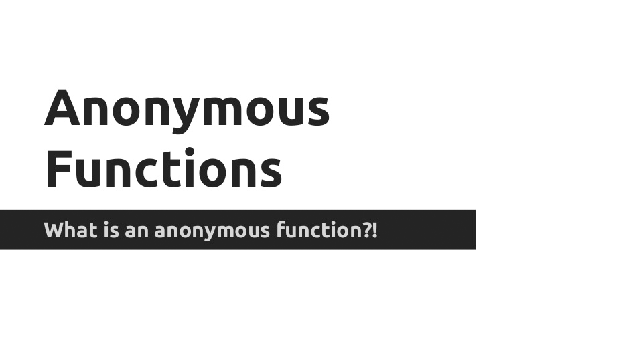

Slide 11
Anonymous Functions
1. JavaScript Basic
1.1. Arrow Functions
1.2. Anonymous Functions
1.3. IIFE (Immediately Invoked Function Expression)
1.4 Higher Order Functions
1.4.1 Map
1.4.2 Reduce
1.4.3 Filter
1.4.4 ForEach
1.6 DOM and Virtual DOM
1.7 JavaScript Selectors
1.8 JavaScript Events and event handlers
2. Learn more
An anonymous function is a function that is declared without any named identifier to refer to it.
An anonymous function is usually not accessible after its initial creation.
One common use for anonymous functions is as arguments to other functions.
setTimeout(function(){
console.log(“I am Anonymous!!”);
});

Slide 12
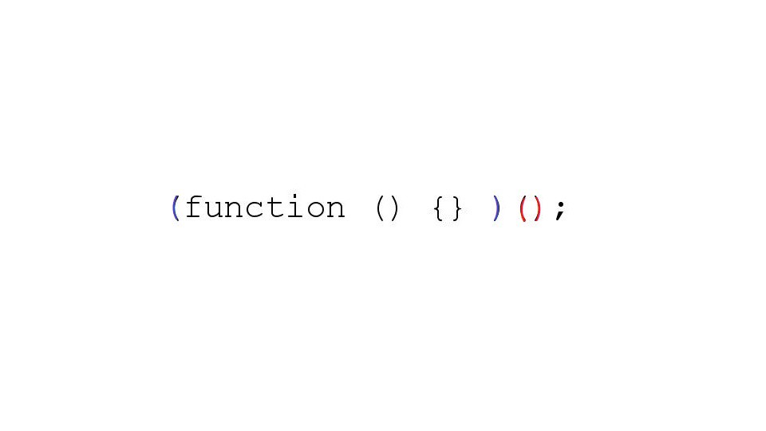

Slide 13
IIFE (Immediately Invoked Function Expression)
1. JavaScript Basic
1.1. Arrow Functions
1.2. Anonymous Functions
1.3. IIFE (Immediately Invoked Function Expression)
1.4 Higher Order Functions
1.4.1 Map
1.4.2 Reduce
1.4.3 Filter
1.4.4 ForEach
1.6 DOM and Virtual DOM
1.7 JavaScript Selectors
1.8 JavaScript Events and event handlers
2. Learn more
An IIFE (Immediately Invoked Function Expression) is a JavaScript function that runs as soon as it is defined.
It is a design pattern which is also known as a Self-Executing Anonymous Function.
We simply want to call a function in order to get an output and never want to use it again and don’t want our program to ever be able to accidentally access it.
(function(){
console.log(“I am Anonymous!!”);
})();

Slide 14
IIFE (Immediately Invoked Function Expression)
1. JavaScript Basic
1.1. Arrow Functions
1.2. Anonymous Functions
1.3. IIFE (Immediately Invoked Function Expression)
1.4 Higher Order Functions
1.4.1 Map
1.4.2 Reduce
1.4.3 Filter
1.4.4 ForEach
1.6 DOM and Virtual DOM
1.7 JavaScript Selectors
1.8 JavaScript Events and event handlers
2. Learn more
The map() method creates a new array with the results of calling a function for every array element.
The map() method calls the provided function once for each element in an array, in order.
This method does not change the original array.
map() does not execute the function for array elements without values.

Slide 15
Map Function
1. JavaScript Basic
1.1. Arrow Functions
1.2. Anonymous Functions
1.3. IIFE (Immediately Invoked Function Expression)
1.4 Higher Order Functions
1.4.1 Map
1.4.2 Reduce
1.4.3 Filter
1.4.4 ForEach
1.6 DOM and Virtual DOM
1.7 JavaScript Selectors
1.8 JavaScript Events and event handlers
2. Learn more
currentValue: Required. The value of the current element index: Optional. The array index of the current element arr: Optional. The array object the current element belongs to thisValue: Optional. A value to be passed to the function to be used as its "this" value.
array.map(function(currentValue, index, arr), thisValue)

Slide 16
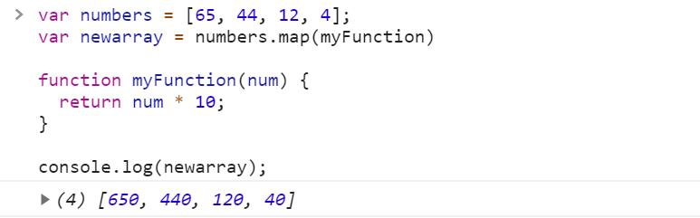
Map Function
1. JavaScript Basic
1.1. Arrow Functions
1.2. Anonymous Functions
1.3. IIFE (Immediately Invoked Function Expression)
1.4 Higher Order Functions
1.4.1 Map
1.4.2 Reduce
1.4.3 Filter
1.4.4 ForEach
1.6 DOM and Virtual DOM
1.7 JavaScript Selectors
1.8 JavaScript Events and event handlers
2. Learn more

Slide 17
Reduce Function
1. JavaScript Basic
1.1. Arrow Functions
1.2. Anonymous Functions
1.3. IIFE (Immediately Invoked Function Expression)
1.4 Higher Order Functions
1.4.1 Map
1.4.2 Reduce
1.4.3 Filter
1.4.4 ForEach
1.6 DOM and Virtual DOM
1.7 JavaScript Selectors
1.8 JavaScript Events and event handlers
2. Learn more
The reduce() method reduces the array to a single value.
The reduce() method executes a provided function for each value of the array (from left-to-right).
The return value of the function is stored in an accumulator (result/total).
reduce() does not execute the function for array elements without values.
this method does not change the original array.

Slide 18
Reduce Function
1. JavaScript Basic
1.1. Arrow Functions
1.2. Anonymous Functions
1.3. IIFE (Immediately Invoked Function Expression)
1.4 Higher Order Functions
1.4.1 Map
1.4.2 Reduce
1.4.3 Filter
1.4.4 ForEach
1.6 DOM and Virtual DOM
1.7 JavaScript Selectors
1.8 JavaScript Events and event handlers
2. Learn more
array.reduce(function(total, currentValue, currentIndex, arr), initialValue)
total: Required. The initialValue, or the previously returned value of the function currentValue: Required. The value of the current element currentIndex: Optional. The array index of the current element arr: Optional. The array object the current element belongs to initialValue: Optional. A value to be passed to the function as the initial value

Slide 19
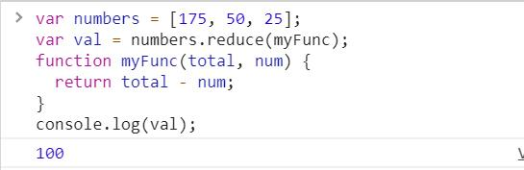
Reduce Function
1. JavaScript Basic
1.1. Arrow Functions
1.2. Anonymous Functions
1.3. IIFE (Immediately Invoked Function Expression)
1.4 Higher Order Functions
1.4.1 Map
1.4.2 Reduce
1.4.3 Filter
1.4.4 ForEach
1.6 DOM and Virtual DOM
1.7 JavaScript Selectors
1.8 JavaScript Events and event handlers
2. Learn more

Slide 20
Filter Function
1. JavaScript Basic
1.1. Arrow Functions
1.2. Anonymous Functions
1.3. IIFE (Immediately Invoked Function Expression)
1.4 Higher Order Functions
1.4.1 Map
1.4.2 Reduce
1.4.3 Filter
1.4.4 ForEach
1.6 DOM and Virtual DOM
1.7 JavaScript Selectors
1.8 JavaScript Events and event handlers
2. Learn more
The filter() method creates an array filled with all array elements that passes a test (provided as a function).
filter() does not execute the function for array elements without values.
filter() does not change the original array.

Slide 21
Filter Function
1. JavaScript Basic
1.1. Arrow Functions
1.2. Anonymous Functions
1.3. IIFE (Immediately Invoked Function Expression)
1.4 Higher Order Functions
1.4.1 Map
1.4.2 Reduce
1.4.3 Filter
1.4.4 ForEach
1.6 DOM and Virtual DOM
1.7 JavaScript Selectors
1.8 JavaScript Events and event handlers
2. Learn more
array.filter(function(currentValue, index, arr), thisValue)
currentValue: Required. The value of the current element index: Optional. The array index of the current element arr: Optional. The array object the current element belongs to thisValue: Optional. A value to be passed to the function to be used as its "this" value.

Slide 22
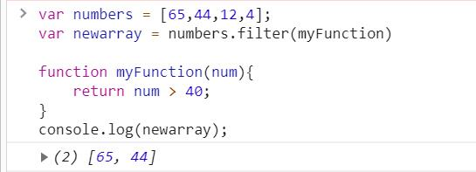
Filter Function
1. JavaScript Basic
1.1. Arrow Functions
1.2. Anonymous Functions
1.3. IIFE (Immediately Invoked Function Expression)
1.4 Higher Order Functions
1.4.1 Map
1.4.2 Reduce
1.4.3 Filter
1.4.4 ForEach
1.6 DOM and Virtual DOM
1.7 JavaScript Selectors
1.8 JavaScript Events and event handlers
2. Learn more

Slide 23
ForEach Function
1. JavaScript Basic
1.1. Arrow Functions
1.2. Anonymous Functions
1.3. IIFE (Immediately Invoked Function Expression)
1.4 Higher Order Functions
1.4.1 Map
1.4.2 Reduce
1.4.3 Filter
1.4.4 ForEach
1.6 DOM and Virtual DOM
1.7 JavaScript Selectors
1.8 JavaScript Events and event handlers
2. Learn more
The forEach() method calls a function once for each element in an array, in order.
The function is not executed for array elements without values.
The provided function may perform any kind of operation on the elements of the given array.
The return value of this function is always undefined. This function may or may not change the original array provided as it depends upon the functionality of the argument function.

Slide 24
ForEach Function
1. JavaScript Basic
1.1. Arrow Functions
1.2. Anonymous Functions
1.3. IIFE (Immediately Invoked Function Expression)
1.4 Higher Order Functions
1.4.1 Map
1.4.2 Reduce
1.4.3 Filter
1.4.4 ForEach
1.6 DOM and Virtual DOM
1.7 JavaScript Selectors
1.8 JavaScript Events and event handlers
2. Learn more
array.forEach(function(currentValue, index, arr), thisValue)
CurrentValue: Required. The value of the current element index: Optional. The array index of the current element arr: Optional. The array object the current element belongs to thisValue: Optional. A value to be passed to the function to be used as its "this" value.

Slide 25
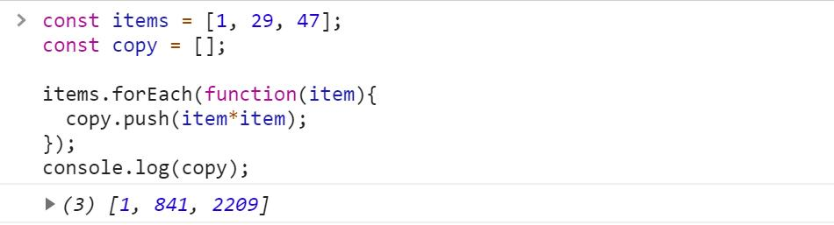
ForEach Function
1. JavaScript Basic
1.1. Arrow Functions
1.2. Anonymous Functions
1.3. IIFE (Immediately Invoked Function Expression)
1.4 Higher Order Functions
1.4.1 Map
1.4.2 Reduce
1.4.3 Filter
1.4.4 ForEach
1.6 DOM and Virtual DOM
1.7 JavaScript Selectors
1.8 JavaScript Events and event handlers
2. Learn more

Slide 26
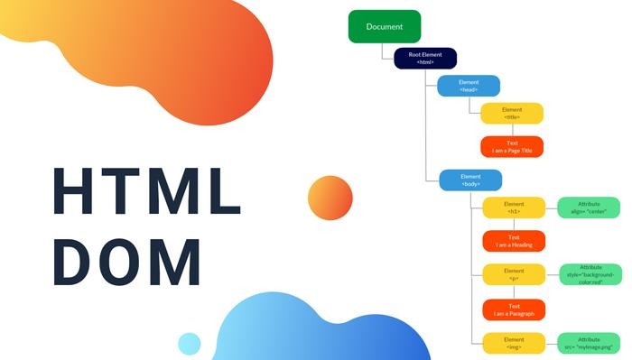


Slide 27
DOM and Virtual DOM
1. JavaScript Basic
1.1. Arrow Functions
1.2. Anonymous Functions
1.3. IIFE (Immediately Invoked Function Expression)
1.4 Higher Order Functions
1.4.1 Map
1.4.2 Reduce
1.4.3 Filter
1.4.4 ForEach
1.6 DOM and Virtual DOM
1.7 JavaScript Selectors
1.8 JavaScript Events and event handlers
2. Learn more
DOM stands for Document Object Model.
It is the data representation of the objects that comprise the structure and content of a document on the web.
It is a programming interface for valid HTML and well structured XML documents.
It defines the logical structure of documents and the way a document is accessed and manipulated.
DOM is a way to represent the webpage in the structured hierarchical way.

Slide 28
DOM and Virtual DOM
1. JavaScript Basic
1.1. Arrow Functions
1.2. Anonymous Functions
1.3. IIFE (Immediately Invoked Function Expression)
1.4 Higher Order Functions
1.4.1 Map
1.4.2 Reduce
1.4.3 Filter
1.4.4 ForEach
1.6 DOM and Virtual DOM
1.7 JavaScript Selectors
1.8 JavaScript Events and event handlers
2. Learn more
DOM can be thought of as a Tree of different html elements, its properties, methods and events.
It is called an “Object Model”, because the document is modeled using objects. The model not only includes the structure but also the behavior of a document.
JavaScript uses this Object Model to interact, manipulate and communicate with the structure of an html page.

Slide 29
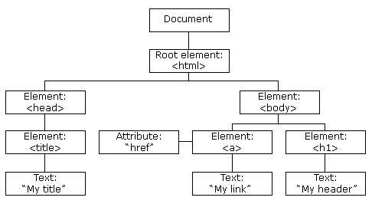
DOM and Virtual DOM
1. JavaScript Basic
1.1. Arrow Functions
1.2. Anonymous Functions
1.3. IIFE (Immediately Invoked Function Expression)
1.4 Higher Order Functions
1.4.1 Map
1.4.2 Reduce
1.4.3 Filter
1.4.4 ForEach
1.6 DOM and Virtual DOM
1.7 JavaScript Selectors
1.8 JavaScript Events and event handlers
2. Learn more
<!DOCTYPE html>
<html>
<head>
<title>My Title</title>
</head>
<body>
<a href=“#”>My Link</a> <h1>My Header</h1>
</body>
</html>

Slide 30
DOM and Virtual DOM
1. JavaScript Basic
1.1. Arrow Functions
1.2. Anonymous Functions
1.3. IIFE (Immediately Invoked Function Expression)
1.4 Higher Order Functions
1.4.1 Map
1.4.2 Reduce
1.4.3 Filter
1.4.4 ForEach
1.6 DOM and Virtual DOM
1.7 JavaScript Selectors
1.8 JavaScript Events and event handlers
2. Learn more
It is a virtual tree which is kept in the browser’s memory and updated in runtime.
It is an object which is very similar to the JavaScript Object.
Virtual DOM is simply a representation of JavaScript DOM object.
It has the same methods, properties and events like the original DOM.
It is simple a concept used by many JavaScript frameworks and libraries, one of which is React JS.

Slide 31
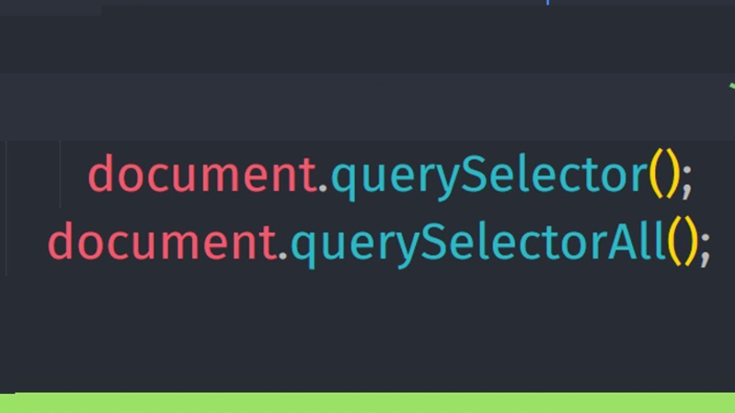
DOM and Virtual DOM
1. JavaScript Basic
1.1. Arrow Functions
1.2. Anonymous Functions
1.3. IIFE (Immediately Invoked Function Expression)
1.4 Higher Order Functions
1.4.1 Map
1.4.2 Reduce
1.4.3 Filter
1.4.4 ForEach
1.6 DOM and Virtual DOM
1.7 JavaScript Selectors
1.8 JavaScript Events and event handlers
2. Learn more
While the DOM re-renders every node even when there is a small change in it. Virtual DOM looks for the node diff.
The VDOM looks for the node diff and only changes the required DOM nodes, resulting in better performance and fast load of the page.

Slide 32
JavaScript Selectors
1. JavaScript Basic
1.1. Arrow Functions
1.2. Anonymous Functions
1.3. IIFE (Immediately Invoked Function Expression)
1.4 Higher Order Functions
1.4.1 Map
1.4.2 Reduce
1.4.3 Filter
1.4.4 ForEach
1.6 DOM and Virtual DOM
1.7 JavaScript Selectors
1.8 JavaScript Events and event handlers
2. Learn more
JavaScript uses the CSS syntax to select and manipulate HTML elements in a DOM.
Selectors are used to "find" (select) HTML elements based on their tag name, id, classes, types, attributes, values of attributes and much more.
In JavaScript, we can select elements in multiple ways as follows: - getElementById(), getElementsByClassName(), getElementsByTagName(), querySelector(), querySelectorAll()
We also need to tell JavaScript from where to select these elements. In most cases it is always the “document” object.

Slide 33
JavaScript Selectors
1. JavaScript Basic
1.1. Arrow Functions
1.2. Anonymous Functions
1.3. IIFE (Immediately Invoked Function Expression)
1.4 Higher Order Functions
1.4.1 Map
1.4.2 Reduce
1.4.3 Filter
1.4.4 ForEach
1.6 DOM and Virtual DOM
1.7 JavaScript Selectors
1.8 JavaScript Events and event handlers
2. Learn more
getElementById() and querySelector() returns (selects) a single DOM.
Where as other selectors either returns an HTML collection or an Array of Node Lists, depending upon which selector type you use.
Depending upon which value the selectors return, we can manipulate the HTML DOM.
querySelector() and querySelectorAll() are the most preferred JS selector to use while programming.

Slide 34
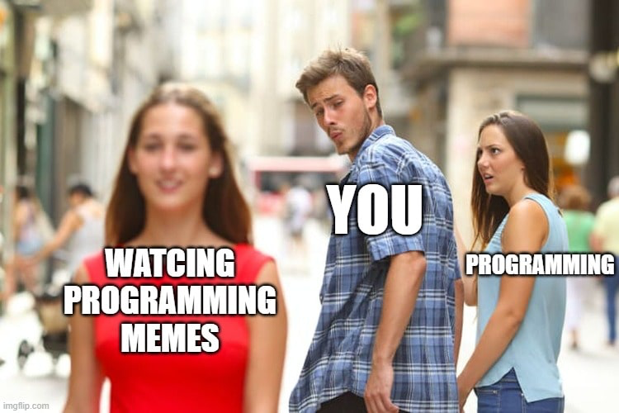

Slide 35


Slide 36
JavaScript Selectors
1. JavaScript Basic
1.1. Arrow Functions
1.2. Anonymous Functions
1.3. IIFE (Immediately Invoked Function Expression)
1.4 Higher Order Functions
1.4.1 Map
1.4.2 Reduce
1.4.3 Filter
1.4.4 ForEach
1.6 DOM and Virtual DOM
1.7 JavaScript Selectors
1.8 JavaScript Events and event handlers
2. Learn more
HTML events are things that happens to an HTML element.
JavaScript's interaction with HTML is handled through events that occur when the user or the browser manipulates a page.
When the page loads, it is called an event. When the user clicks a button, that click too is an event.
We can use these events to execute JavaScript coded responses, which cause buttons to close windows, messages to be displayed to users, data to be validated, and virtually any other type of response imaginable.

Slide 37
JavaScript Selectors
1. JavaScript Basic
1.1. Arrow Functions
1.2. Anonymous Functions
1.3. IIFE (Immediately Invoked Function Expression)
1.4 Higher Order Functions
1.4.1 Map
1.4.2 Reduce
1.4.3 Filter
1.4.4 ForEach
1.6 DOM and Virtual DOM
1.7 JavaScript Selectors
1.8 JavaScript Events and event handlers
2. Learn more
Events in JavaScript are handled by an Event Handlers.
They are JavaScript code that are not added inside the <script> tags, but rather, inside the html tags, that execute JavaScript when something happens, such as pressing a button, moving your mouse over a link, submitting a form etc.
Here, onClick is the JavaScript event handler.
While this is a good example of getting to know how events work, JavaScript also has a method called “Event Listener”. Lets Explore.
<a href="http://google.com" onClick="alert('hello!')">Google</a>

Slide 38
JavaScript Selectors
1. JavaScript Basic
1.1. Arrow Functions
1.2. Anonymous Functions
1.3. IIFE (Immediately Invoked Function Expression)
1.4 Higher Order Functions
1.4.1 Map
1.4.2 Reduce
1.4.3 Filter
1.4.4 ForEach
1.6 DOM and Virtual DOM
1.7 JavaScript Selectors
1.8 JavaScript Events and event handlers
2. Learn more
An event listener is a method that attaches an event handler to a specific element.
This way we do not always have to rely on writing our codes in HTML itself.
The best way to work around with events is using an event listener method.
To use an event listener, we must first select an element on which to attach the event.

Slide 39
JavaScript Selectors
1. JavaScript Basic
1.1. Arrow Functions
1.2. Anonymous Functions
1.3. IIFE (Immediately Invoked Function Expression)
1.4 Higher Order Functions
1.4.1 Map
1.4.2 Reduce
1.4.3 Filter
1.4.4 ForEach
1.6 DOM and Virtual DOM
1.7 JavaScript Selectors
1.8 JavaScript Events and event handlers
2. Learn more
Now that we know how to select an element, lets look at the following example:
We created an <a> element and assigned an ID to it. We then selected that element using the getElementById() method in JavaScript. Finally we attached an event handler (click) to alert “hello!”.
Now, whenever a user clicks the button, it will show an alert with the message “hello!”.
<a href=“#” id=“myBtn”>Show Alert</a>
document.getElementById("myBtn").addEventListener("click", () => alert(“hello!”));

Slide 40
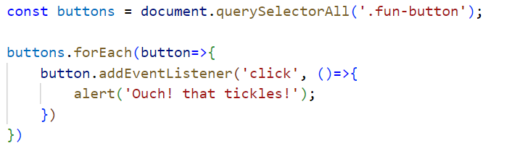
JavaScript Selectors
1. JavaScript Basic
1.1. Arrow Functions
1.2. Anonymous Functions
1.3. IIFE (Immediately Invoked Function Expression)
1.4 Higher Order Functions
1.4.1 Map
1.4.2 Reduce
1.4.3 Filter
1.4.4 ForEach
1.6 DOM and Virtual DOM
1.7 JavaScript Selectors
1.8 JavaScript Events and event handlers
2. Learn more
Now, in event.js file we have created a variable buttons using const keyword where we have selected all the buttons using qerySelectorAll(). We have given a behavior on those buttons which on click gives an alert of (‘Ouch! that tickles);

Slide 41
JavaScript Selectors
1. JavaScript Basic
1.1. Arrow Functions
1.2. Anonymous Functions
1.3. IIFE (Immediately Invoked Function Expression)
1.4 Higher Order Functions
1.4.1 Map
1.4.2 Reduce
1.4.3 Filter
1.4.4 ForEach
1.6 DOM and Virtual DOM
1.7 JavaScript Selectors
1.8 JavaScript Events and event handlers
2. Learn more
There are numerous event handlers for you to explore. Below are listed some of the most used handlers for you too look into: - onClick - ondblclick - onkeypress - onkeyup - onmousein - onmouseout - onsubmit

Slide 42




